Slide 1
Jenkins
Presented by: Shantanu Mane

Slide 2
Agenda
What is CI
Jenkins – CI server
Why Jenkins
Benefits of Jenkins
Jenkins Architecture
Master Slave Concept
Best Practices
Short Demo

Slide 3
What is Continuous Integration / Continuous Delivery / Continuous Deployment
Continuous integration (CI) is the practice of automating the integration of code changes from multiple contributors into a single software project.
Continuous integration refers to the build and unit testing stages of the software release process.
The key goals of continuous integration are to find and address bugs quicker, improve software quality, and reduce the time it takes to validate and release new software updates.
Continuous delivery is a software development practice where code changes are automatically prepared for a release to production
Continuous deployment is a strategy in software development where code changes to an application are released automatically into the production environment

Slide 4
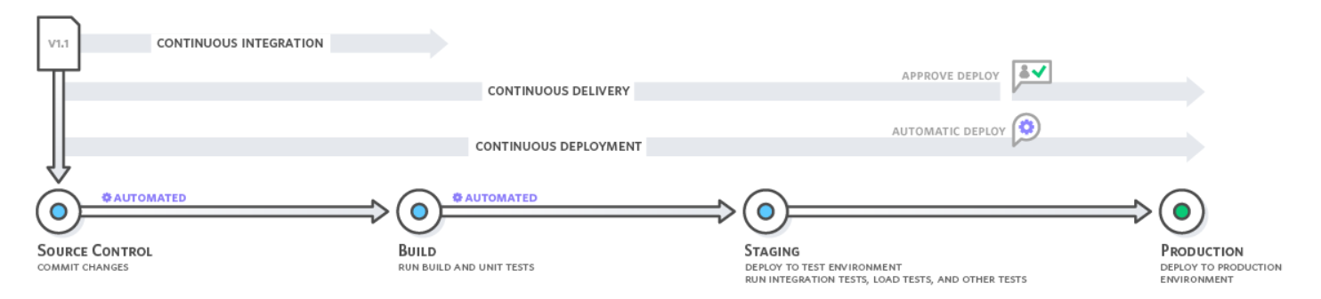

Slide 5
Life without Continuous Integration
Manual Integration
Delayed Feedback
Reduced Confidence
Difficulty in Collaboration
Deployment Challenges
Lack of Visibility

Slide 6
Life with Continuous Integration
Automated Testing
Faster Feedback Loops
Early Detection of Integration Problems
Improved Collaboration
Enhanced Code Quality
Continuous Improvement

Slide 7

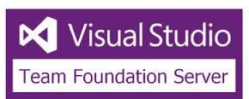




Popular CI Servers

Slide 8
Jenkins History
2005
Hudson was first released by Kohsuke Kawaguchi of Sun Microsystems
2010
Oracle bought Sun Microsystems and continue with Trademark with Hudson
Feb, 2011
Hudson was renamed to Jenkins
2011
Kawaguchi became the chief Technology officer for Cloudbees
Apr, 2016
Jenkins 2.0 is released
Jenkins Replaced Hudson
Feb, 2017

Slide 9
Why Jenkins
Jenkins is an open-source tool with a large and active community.
Jenkins is highly extensible through its vast ecosystem of plugins.
Automates the build, artifact management and deployment processes
Jenkins supports multiple platforms, languages, and build tools, making it suitable for a wide range of projects
Easy to install and use
Supports distributed builds using Master/Slave Architecture

Slide 10
Benefits Of Jenkins
Spend less time
Flexibility
Widely adopted
Reduce integration problems
bug-free state
Immediate unit and integration testing
Immediate feedback
Self-hosted

Slide 11
Jenkins vs TeamCity vs Bamboo
Features | Jenkins | TeamCity | Bamboo
Pricing | Free | Free for 100 build configuration. It starts at $299 per year after 100 | It starts at $10 with limited experience. License versions cost$880 for one remote agent
Plugin Support | Offers speed and more than 1500+ plugins | More than Bamboo less than Jenkins | 100+ plugins
Hosting | On-premise/cloud-based | On-premise | On-premise/BitBucket as a cloud
Open Source | Yes | No | No

Slide 12
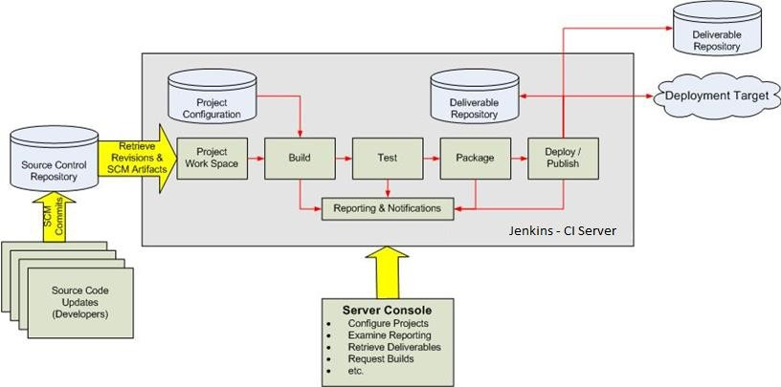
Jenkins Architecture

Slide 13
Jenkinsfile
A Jenkinsfile is a text file that defines the entire pipeline for a Jenkins job
It's written in Groovy syntax
Jenkinsfiles are a powerful way to define and manage your Jenkins pipelines, enabling you to automate and streamline your software delivery process effectively
It’s generally considered a best practice to create a Jenkinsfile and check the file into the source control repository
Pipeline supports two syntaxes –
Declarative pipelines
Scripted pipelines

Slide 14
Advantages of Jenkinsfile
Version Control: Jenkinsfiles can be stored alongside your project code in version control systems like Git, providing visibility into changes and allowing for easy collaboration.
Reusability: Jenkinsfiles can be shared and reused across multiple projects, promoting consistency and reducing duplication of effort.
Flexibility: Jenkinsfiles support complex workflows with conditional logic, parallel execution, error handling, and integration with external tools and service

Slide 15
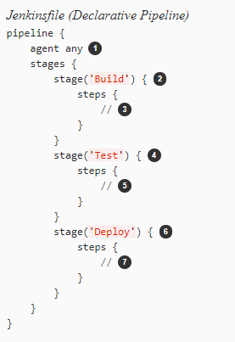
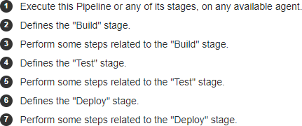
Jenkins file – declarative pipeline

Slide 16
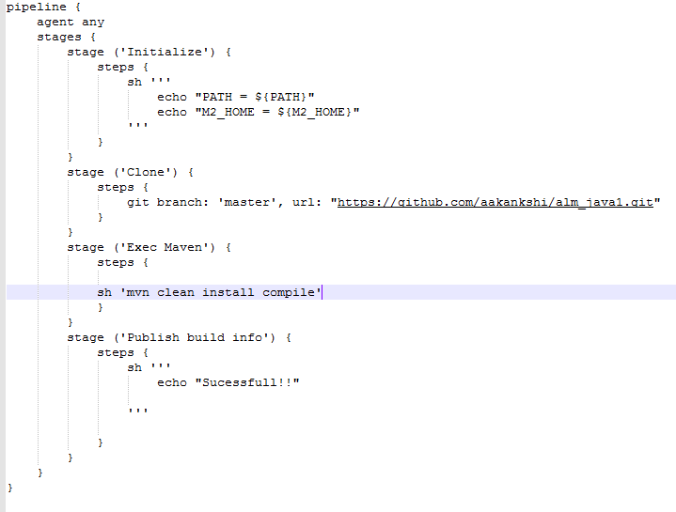
Jenkinsfile – declarative pipeline

Slide 17
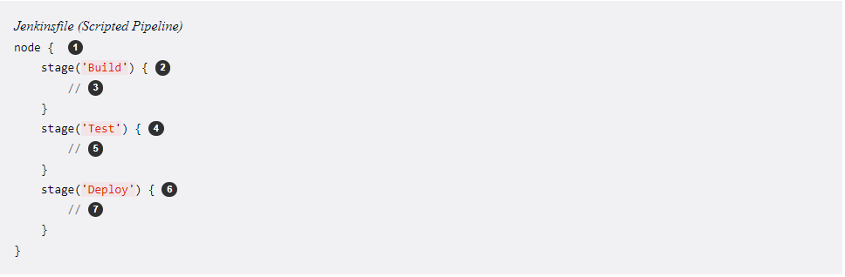
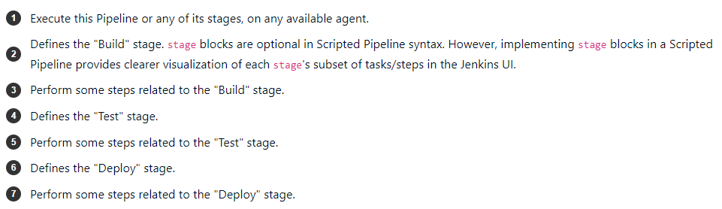
Jenkinsfile – scripted pipeline

Slide 18
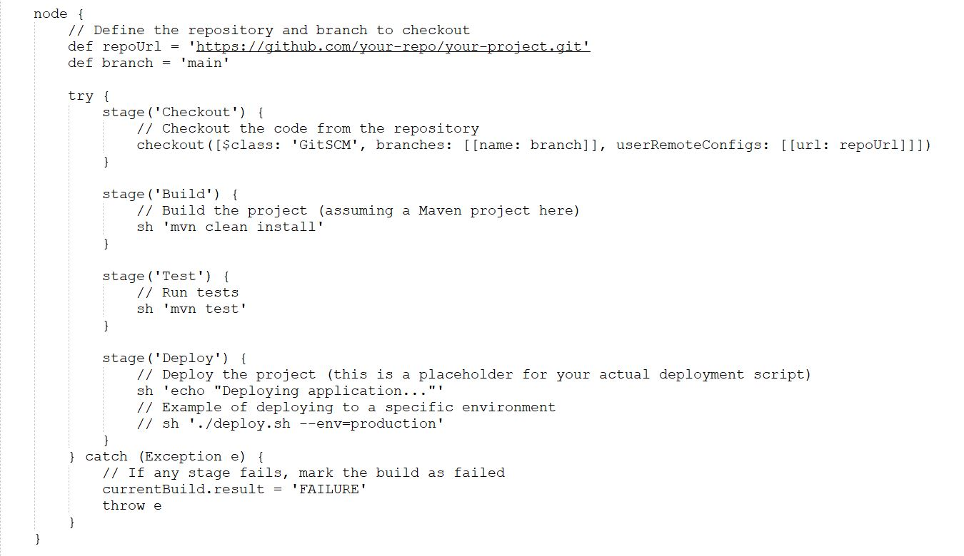
Jenkinsfile – scripted pipeline

Slide 19
Executors in Jenkins
An executor is a process that runs a build/job
You are able to run one job at a time if you have one executor. If you have two executors, you are able to run two jobs in parallel and so forth.
types of executors in Jenkins :
Jenkins Master Executor
Jenkins slave Executor
Docker Executor
Kubernetes Executors
SSH Executors

Slide 20
Jenkins Build Trigger
Different ways to trigger the build
Build Periodically
Poll SCM: This trigger periodically checks your version control system (such as Git or SVN) for changes and starts a build if new commits are detected.
Schedule Trigger (Build Periodically): This trigger allows you to schedule builds at specific times or on a recurring basis using cron syntax.
Webhook Trigger: Many version control systems support webhooks, which enable them to notify Jenkins immediately when a new commit is pushed.
Triggering from Other Jobs (Build After Other Projects are Built): Jenkins jobs can be configured to trigger other jobs upon successful completion.
Poll the SCM for changes – Poll the version controlled repository at the specified intervals and start executing the build if any changes committed to repository.

Slide 21
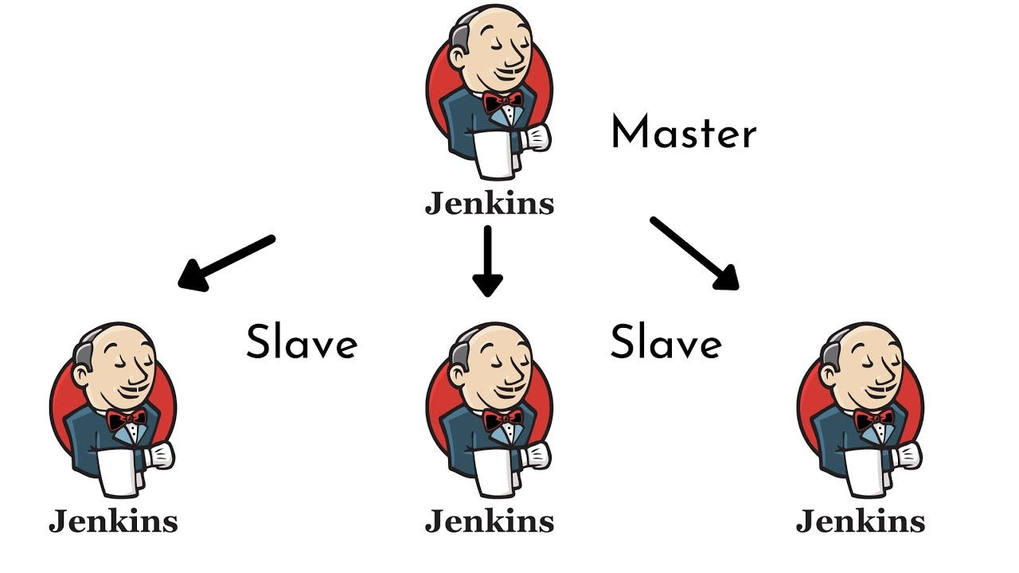
Jenkins Master/Slave
Master/slave architecture to manage distributed builds.
Master
handle scheduling build jobs
dispatching builds to the slaves for
the actual execution
monitor the slaves and recording and
presenting the build
Slave
small Java executable that runs on a remote machine and listens for requests from master

Slide 22
JNLP Protocol
Different ways to trigger the build
Build Periodically
The JNLP (Java Network Launch Protocol) is a protocol used by Jenkins to launch its agents (also known as slaves or nodes) on remote machines.
How JNLP Works -
Agent Launching: When a build job is triggered and requires a worker node, Jenkins uses JNLP to initiate the launch of an agent process on a remote machine.
Communication: Once the agent process is launched, it establishes a communication channel with the Jenkins master using JNLP. This communication channel allows the master to send build instructions to the agent and receive status updates and build logs in return.
Dynamic Provisioning: Jenkins can dynamically provision agents on-demand based on workload using JNLP. This allows for elastic scaling of build capacity, where new agents are launched as needed to handle increased load, and terminated when they're no longer needed.
Security: JNLP connections in Jenkins can be secured using encryption and authentication mechanisms to ensure that only authorized agents can connect to the master, and that communication between the master and agents is secure.
Poll the SCM for changes – Poll the version controlled repository at the specified intervals and start executing the build if any changes committed to repository.

Slide 23
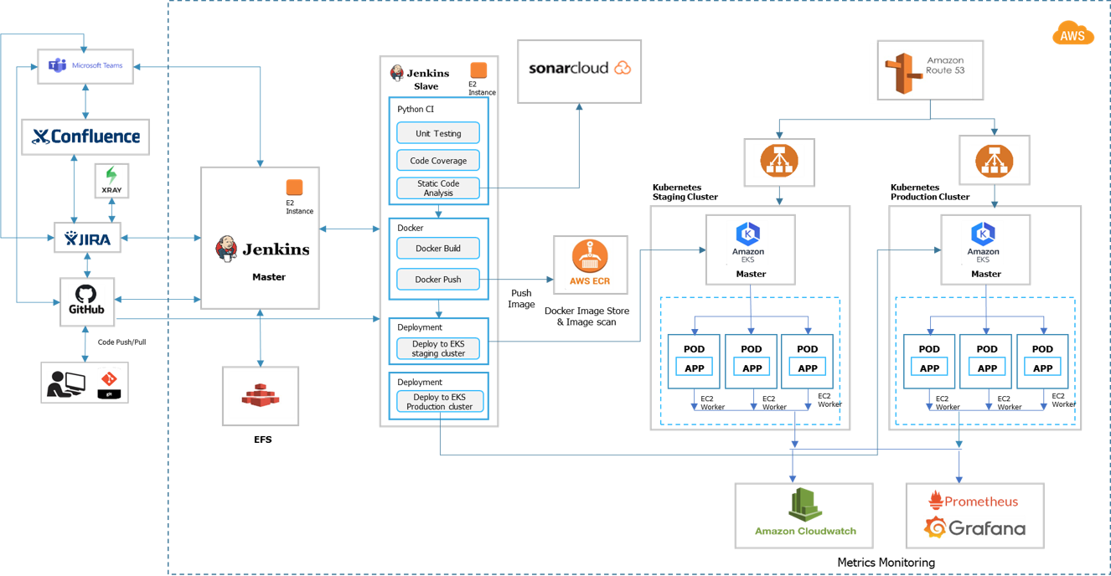
Case study

Slide 24
Best Practices
Do not use default user/password for Jenkins, use SAML, SSO for Authentication
Use Matrix or RBAC strategy for user permissions in Jenkins
Jenkins servers should be behind ALB and not accessed using IP address
Worker nodes will only need port 22 to be open for communication with a master. They will not need port 8080 open
All jobs should be run on Jenkin’s agents not on master
Always use persistent file system storage like AWS EFS for Jenkins
Configure Jenkins with HTTPS protocol and trusted certificate
Keep credentials at pipeline level or folder level
If Jenkins is deployed as container, use hardened and secure images
Always use master-slave architecture
Take Jenkins backup regularly
Keep credentials at pipeline level or folder level
Always check plugin UI for vulnerabilities in existing plugins

Slide 25
Installation of Jenkins

Slide 26


Copyright © 2021 Cybage Software Pvt. Ltd. All Rights Reserved. Cybage Confidential.
www.cybage.com

Slide 27


Thank You!
6/21/2024
www.cybage.com
Copyright © 2021 Cybage Software Pvt. Ltd. All Rights Reserved. Cybage Confidential.

